Slide 1
Increasing Physical Activity and Wellness
Camie Powell
Director of Marketing and Corporate Relations

Slide 2
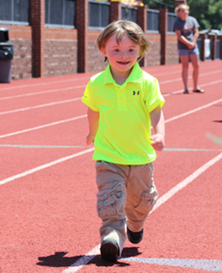
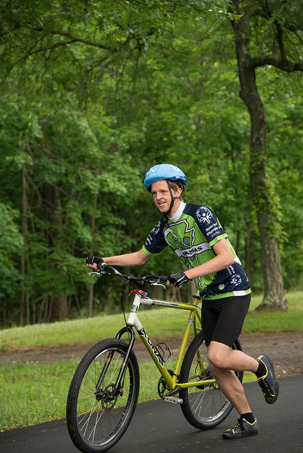
Dispelling Myths
Age
Sports
Year-round
Ability
“Nice”
Notes:
Special Olympics works with ages 2 and up. Athletes have the opportunity to compete at 80 if they desire. People typically think of school age students when they think of Special Olympics
Special Olympics Arkansas hosts 20 different sports, most people think of us as Track and Field only
Special Olympics programming exists year-round. In fact we host 240 competitions in Arkansas each year. On Any give month that is 11-19 competitions going off across the state.
Special Olympics traditionally service people with intellectual disabilities e.g. Down Syndrome, Fragile X, Autism (40% of people with autism also have an intellectual disability).
Special Olympics can be seen as a “ Nice” organization when in fact we are a necessary and urgent movement focused on showcasing real athletic ability for people with intellectual disabilities. We focus on increasing health and wellness for our athletes and smash the worlds stereotypes of who are athletes really are and their capabilities.

Slide 3
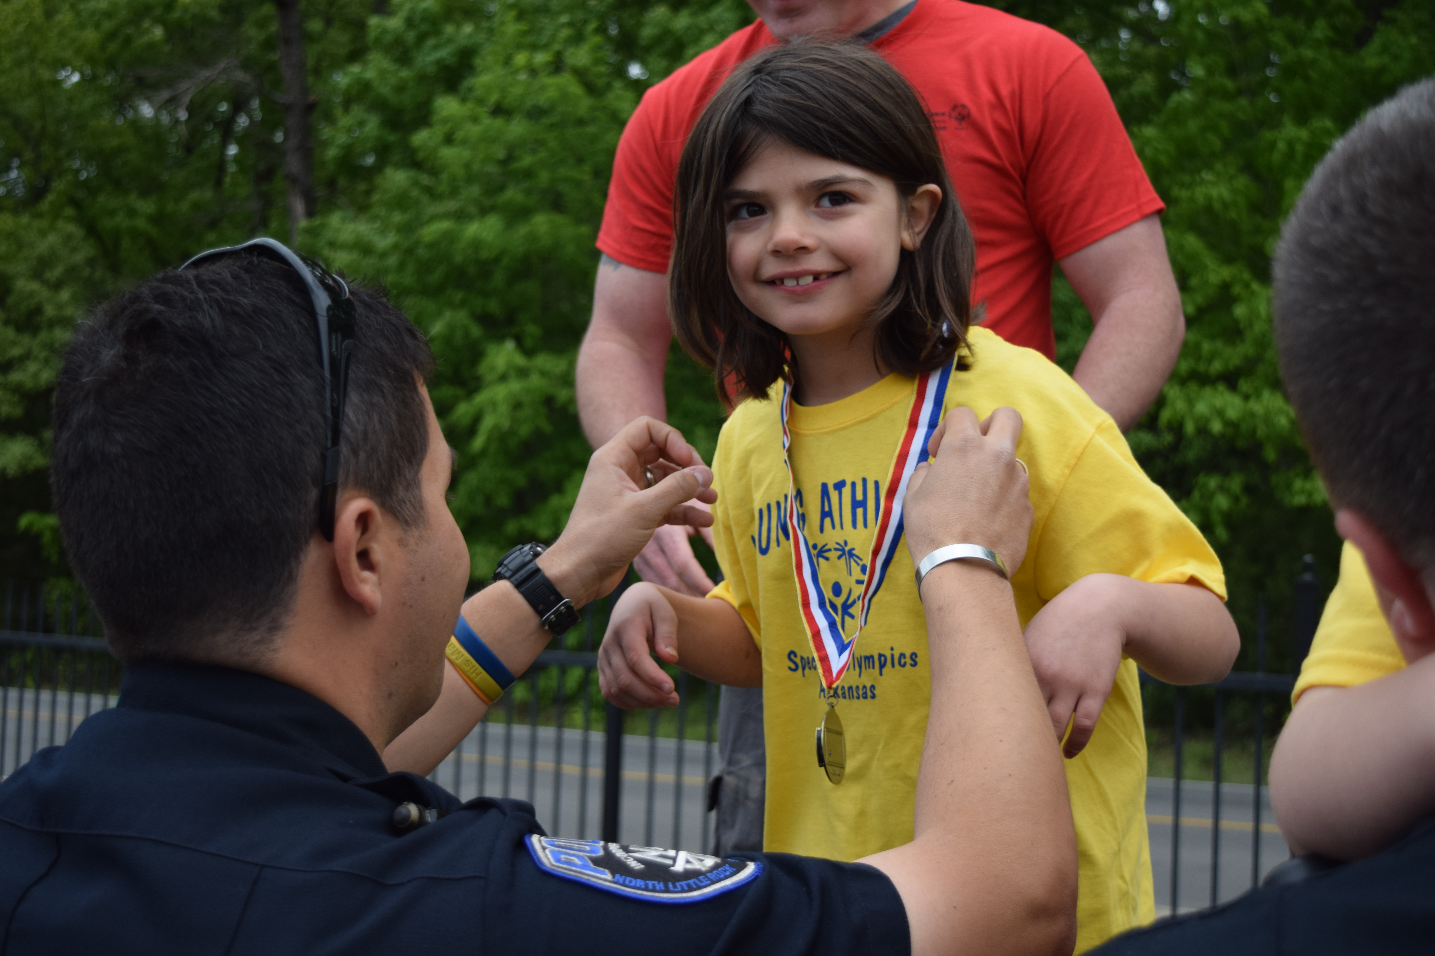
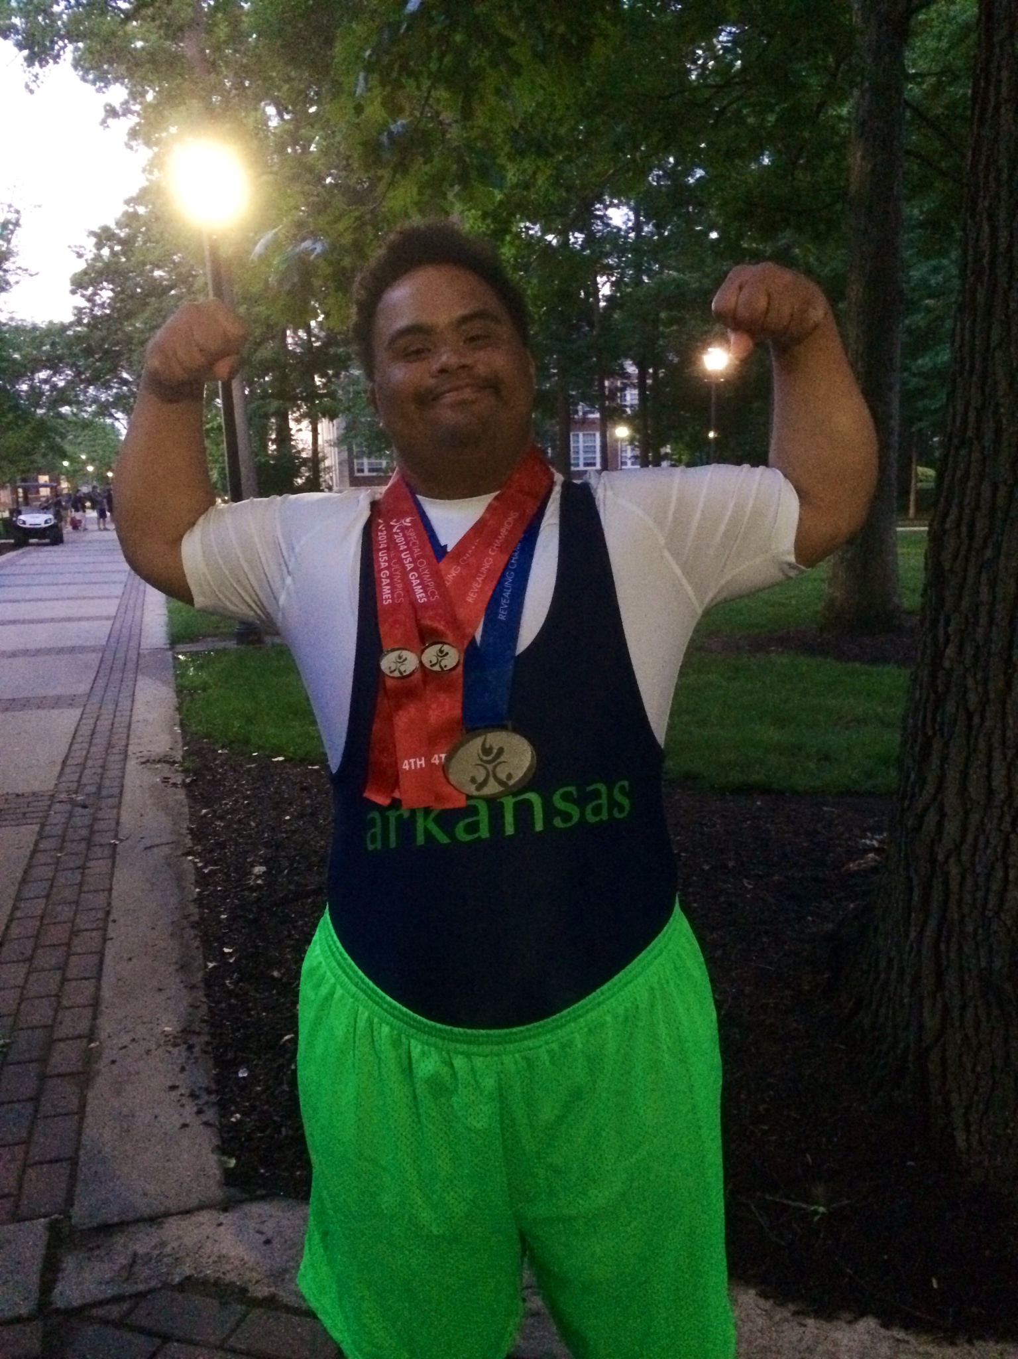
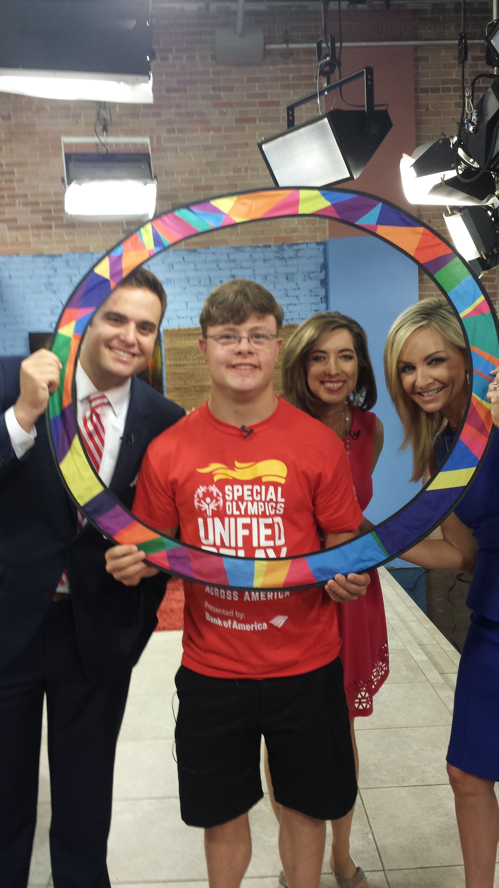
Impact
Family
Focus on the Ability
Greater Self Confidence
Goals
5x more likely to be gainfully employed
Triumph and Defeat
Social Networking
Average athlete competes more than 10 years
Opportunity
Improved Health
Notes:
Our athletes are 5 x more likely to be gainfully employed than their counterparts that do not participate in Special Olympics
Our athletes seek goals and improved health
Special Olympics gives families a larger net of family to bond with and a chance to see their child succeed and exceed traditional expectations
Special Olympics athletes understand Triumph and Defeat. Not everyone gets a gold medal. They work hard to get on the medal stand

Slide 4
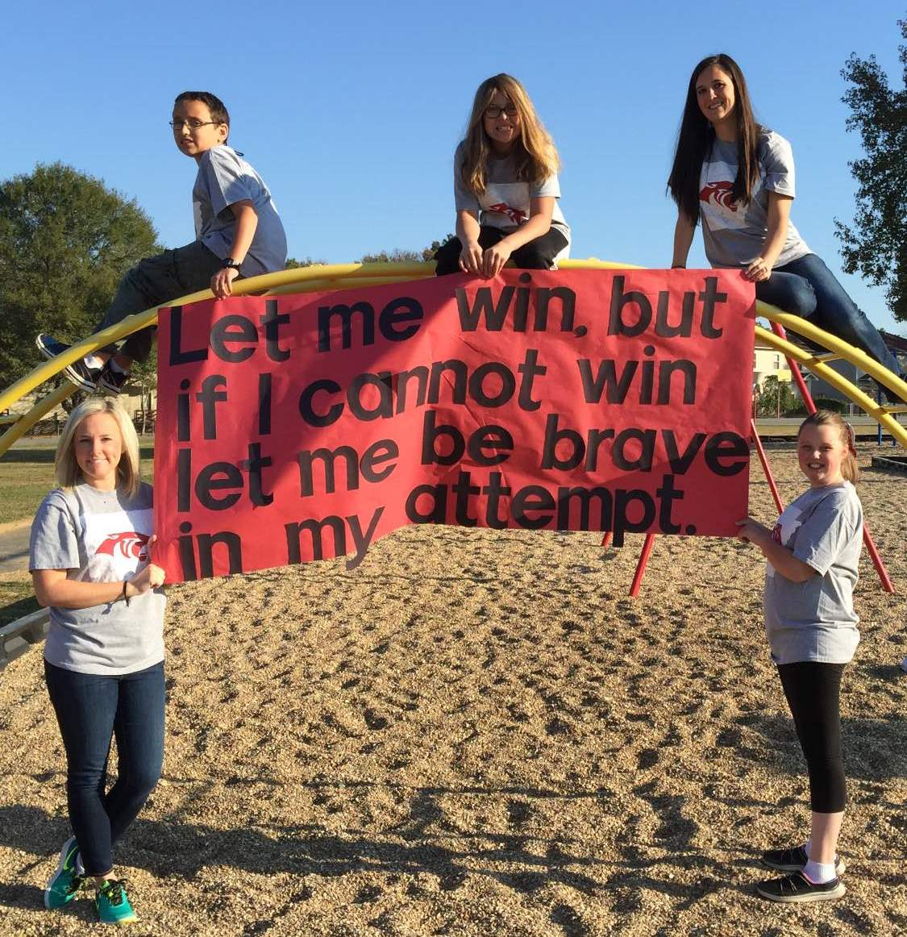
“I wanted to reach out to you and tell you what an impact this organization has had not only my students, but myself as well. I am a fifth year, Special Education teacher in Cabot Arkansas. My students over the years have had varied disabilities, ranging from Down Syndrome, ODD, Intellectual Disability to Autism. The one thing that all of my students have in common, is their love for Special Olympics. Your organization gives my students hope, it allows them to feel a sense of normalcy, and it makes an life-long impact their lives. I hope you realize just how incredible and life changing this organization is. I am so thankful that I get to witness the magic first-hand. Thanks for all that you do,” Chelsea Verdier.
Notes:
Please read this impact statement – this is why we consider ourselves necessary and urgent

Slide 5
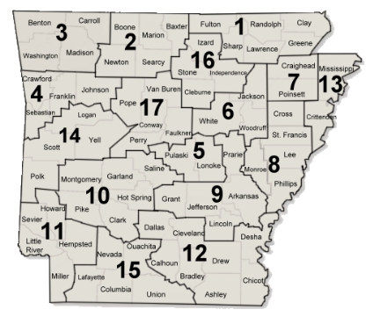
Understanding Special Olympics
Traditional Competition 8 and up
Local Participation through Area competition
2013 Introduction of Young Athletes program
Notes:
Athletes have the opportunity to compete at Area level competitions year-round. Based on success of their area competitions they may qualify for State level competition.
Parents can search for their Area events on the Special Olympics Calendar: http://www.specialolympicsarkansas.org/calendar.html
Young Athletes competitions are available across the state and will be listed on the calendar
It is not required that Young Athletes attend competitions. Most Young Athlete programming is executed within a center or school. However the opportunity for a parent to get their child registered for Young Athletes events outside of their school is possible

Slide 6
Young Athletes
Notes:
Traditional Special Olympics Competition focused on ages eight and up. It became obvious to Special Olympics that sport development needed to start earlier to ensure involvement and overall increased health.
You might foresee an objection to running a Special Olympics curriculum for their student without a disabilitiy. A suggested way to overcome this would be: This programming at its core teaches fundamental sports development training all students can use. The Special Olympics title means that it also has necessary adaptation for those students that may need it. Your child with or without a disability will learn proper technique on several different sports.

Slide 7
Introduction to Young Athletes
Special Olympics Young Athletes™ is an early childhood sports play program including games, songs and other fun physical activities for children
Embraces Ages 2-7
Inclusive programming
Meeting the needs for vigorous play
Solution for structured activity time
Rather than play this program moves your center to intentional sport development
Visual progress

Slide 8
Curriculum Structure
24 Scripted lessons (flexible breakdown)
3 days a week for 30 minutes
Or is there another way this fits in your schedule?
Multiple cycles of the lessons will reflect beginner to advanced movement
Each student performs at their ability level
Supplemental Materials: Nutrition/physical activity education program through AETN to accompany ( Healthy Habits for Life)
Ability to use this model for testing improvement
Evidence based records
Elevated opportunity once the class has completed first round of curriculum

Slide 9
When to run the curriculum
Starting off a traditional school year
This will allow for at least two cycles of the curriculum if desired
Fall and Spring development schedules (spring hosting more advanced skills)
Summer programming
Utilize this as a way to engage school age students with your young athletes during a scheduled time

Slide 10
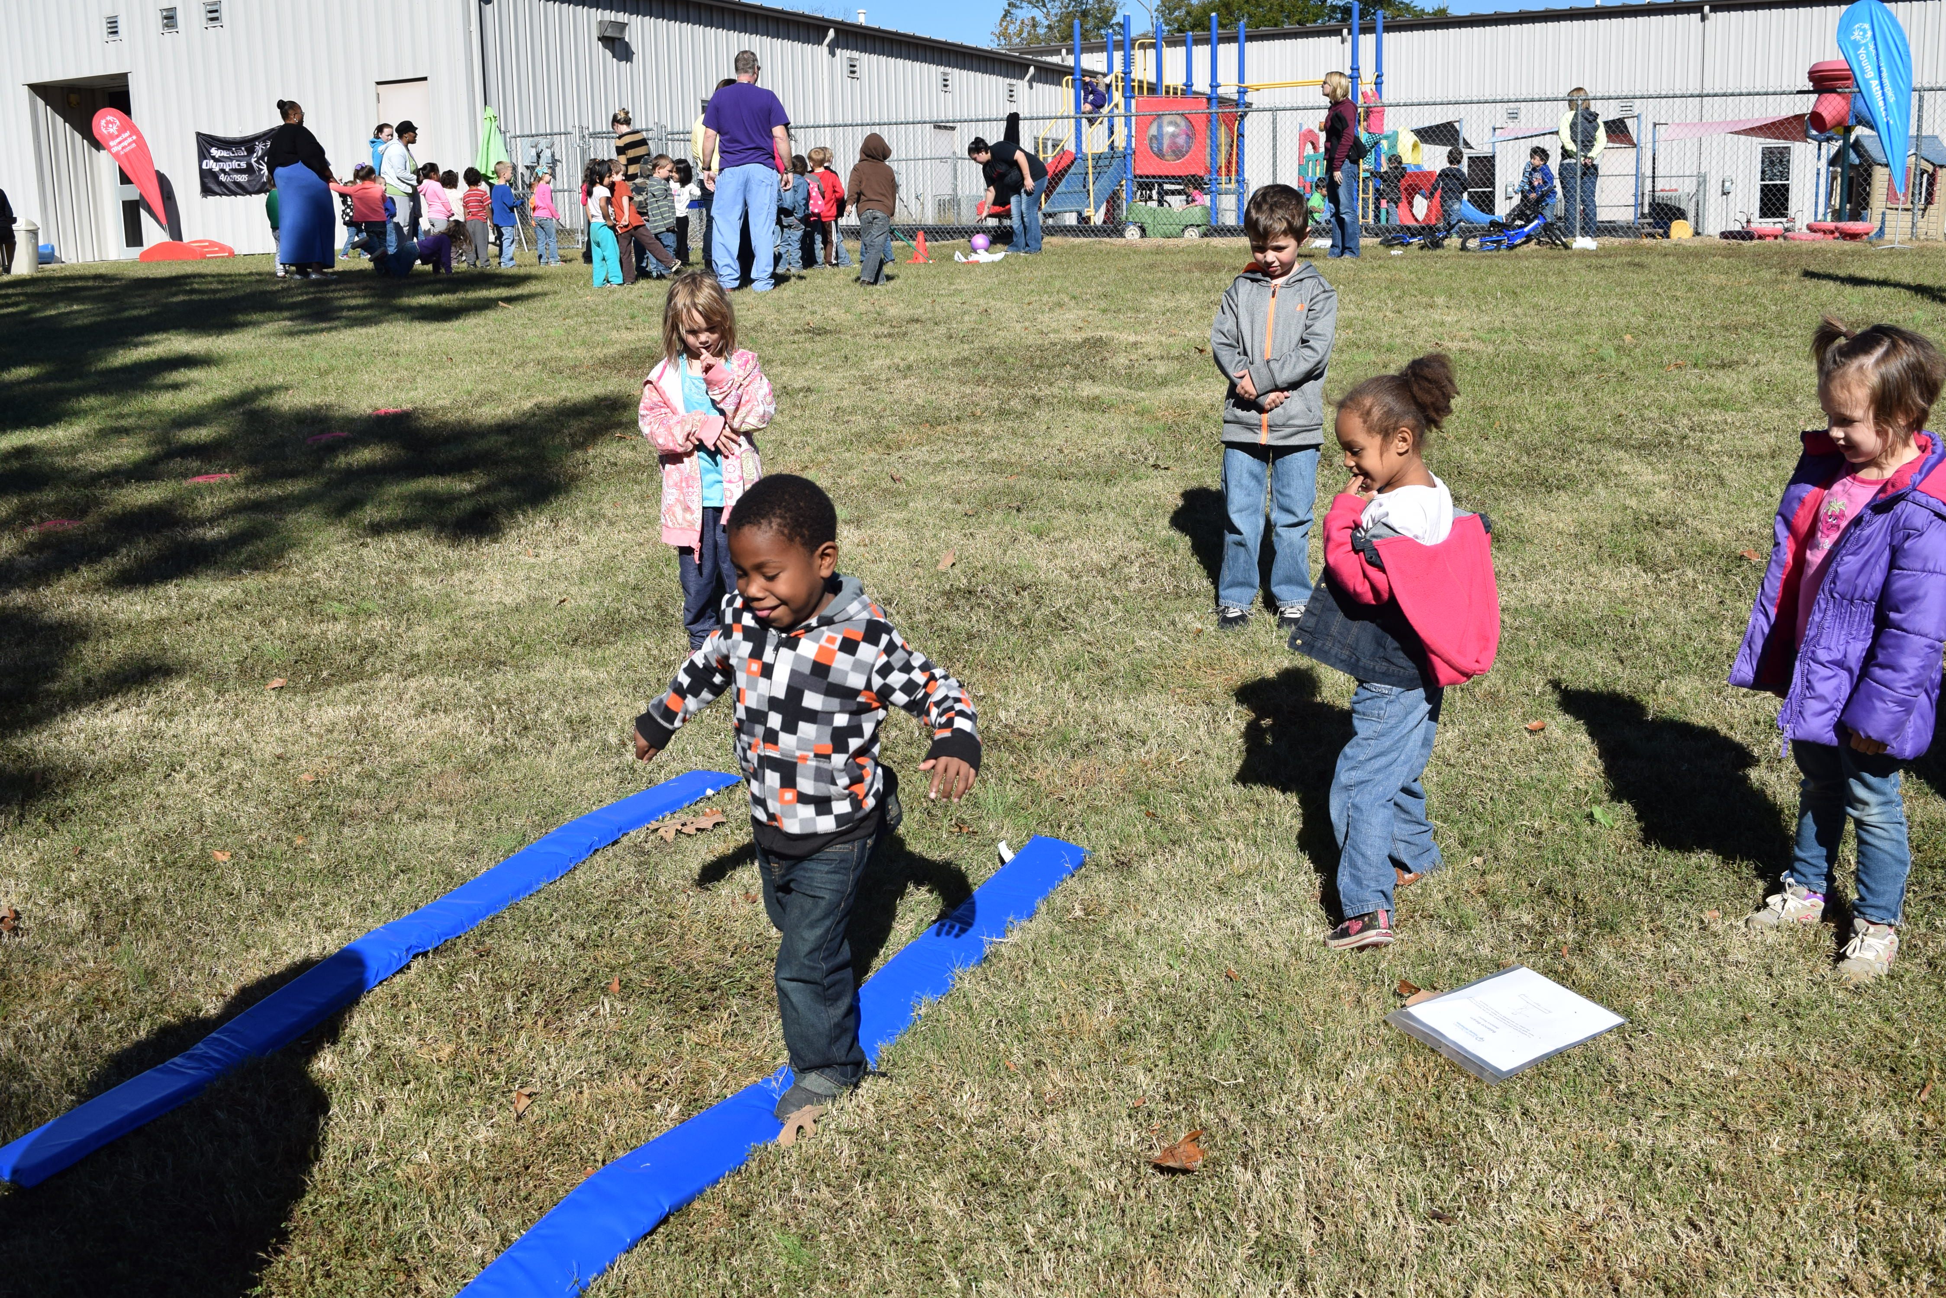
Materials Available
An illustrated Activity Guide
training videos help families, volunteers and professionals learn about and lead the activities.
Curriculum book and free website
Materials Kit (substitutions home use)
Access to SOAR for additional materials

Slide 11
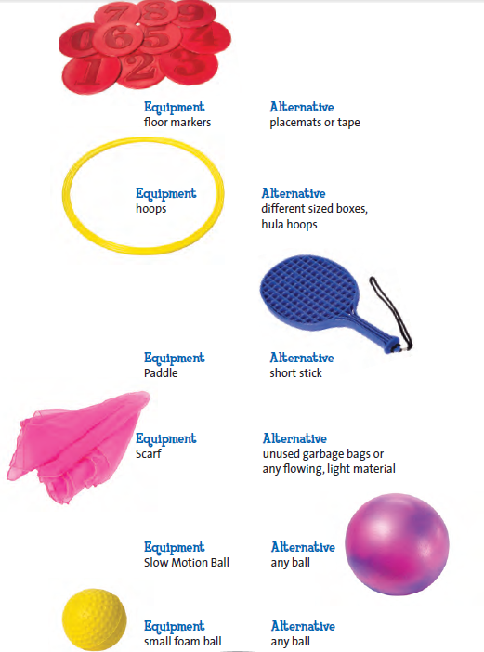
Equipment
Notes:
Kits can be purchased through Jennifer@specialolympicsarkansas.org and they are 99.00 plus tax

Slide 12
The Overview of
Lesson Plans
provides details on what and who you need to implement the Lessons.
Notes:
Facilitator Notes: For this slide, the facilitator will read over each section (adults needed, time, sequence, resources, playing at home), and participants will receive a handout featuring the overview in their binder.
Script:
Each week, the Overview page will guide you on exactly WHAT and WHO you need you implement the Lessons. Too, it tells you how to share the Lessons with families so they can Play at Home.
With your table, can you tell us how many lessons are provided for each skill area in Week One? (HINT: it’s under Sequence: 3 lessons). Ask participants to share out.
What tool will families use so they can play the activities at home? (HINT: It’s under Playing at Home: Lesson Plan Summary Cards, and/or Activity Guide and Videos). Ask participants to share out.
Adults Needed: Plan for at least 1 adult for every 4 children. Recruit help from families, volunteers, older students, college students and others in your community to make sure the program runs smoothly and is fun.
Time: Young Athletes is implemented with great enthusiasm, high energy and quick pace. Time estimates are provided to guide completion of each lesson in 30 minutes. However, the pace and length of the lesson should be matched to the needs, interests, ages, and skills of the young athletes in your group.
Sequence: There are three lessons for each skill area labeled Day One, Day Two and Day Three. Lessons within the skill area are designed to be offered in sequence to help children become acquainted with the activities and build skills through repetition. We will review week 1 shortly.
Resources: The Lesson Plan Summary Cards include an outline of the activities, list of equipment needed, and page numbers to find the activity descriptions. The cards, Young Athletes Activity Guide, Suggestions from Coaches/Teachers, and training videos are included in the online Toolkit (see website)
Playing at home: Give families the Lesson Plan Summary Cards and encourage them to sing the songs and play one or two games with their child at home before the next session. Help them learn about the activities by including them in your group sessions and/or providing a family training session. Be sure they have access to the Activity Guide and Videos for more information.

Slide 13
The header of the
Lesson Plans
provides details on the focus of the week, and when you will implement the Lessons.
Notes:
Trainer Note: The following activity may be best if the group is small and time allows. Feel free to do this activity in presentation format or as a large group brainstorm
Script:
At the top of the next page, you will see that this week, we're focusing on Foundational Skills. Day 1 is circled, so you know that this is where the curriculum begins.
Each Young Athletes session begins with the Opening Sports Song. Ask participants, Can you think of why we might begin with this song?
Take a moment to read through PURPOSE. Can someone summarize the purpose for us?
A: The purpose, or objective, of singing the SS is to gather the group, to warm up with motions, and create body awareness and support adaptive skills). Consider the huge opening ceremony at the Olympic Games- there is always music, momentum, and fun. This is a chance for you to infuse all of those things into your site’s Opening song. Maybe your athletes could march around your classroom or house, proudly singing the opening song to initiate that it's time to let the games begin!
To the right of Opening Sports Song, you will see the time allocated to this component of the day. 30 minutes will fly by! As a coach, it will be important to balance your time so that you're keeping on track with the lessons while meeting the needs of your individual athletes. This time allocation is an estimate. The more you practice the Opening Song, the easier this part of the day will be.
Now that you as coaches know the purpose, you need to be able to share that with your athletes. EXPLAIN offers a simple script you can use to make sure you tell your athletes WHY we do what we do each session. Remember, this is the first day, so you will need to help them develop a sense of the daily schedule and routines. This lays the foundation for smoother transitions, more fun, and more productivity each time you do Young Athletes.

Slide 14
Notes:
Script:
On page 4, we get to the heart of the lessons. Our first activity is I Spy, and you also have 5 minutes dedicated to this lesson.
Take a moment to scan through this lesson. What is the PURPOSE? Share with your table mates.
Briefly read through DEMONSTRATE, and LEAD. What is the difference between these two components? Why do we need both?
DEM. Offers a transition from the warm up to introducing what the Activity is, and it shows children HOW to do it “I spy with my little eye…”
LEAD is where you extend the Activity to your athletes, involving them and helping them to play the Activity “let’s walk to the balls. Where’s the blue ball?”
The bullets offer specific guidance on HOW to lead the athletes.

Slide 15
Notes:
Script:
On day 1, you will also aim to complete the additional activities Scarf Game, Inchworm Wiggle, Bridges and Tunnels, and Closing Sports Song.
Keep in mind that you will want to move at the pace that is appropriate for your athletes, and you can always make a note of which activity you may need to re-introduce or introduce in session 2.

Slide 16
Each lesson offers Tips on observing Athletes.
Notes:
Script:
On Page 6, you will see a blue box on the left hand side that offers Tips on observing the Athletes. Take a moment to read through this tip for Bridges and Tunnels.
Later on, we will discuss different ways you will document your athlete's participation in Young Athletes. These Tips offer great guidance on things you should look for in their physical and social-emotional growth over the course of the program.

Slide 18
Week, Day, Skill focus area
Equipment needed
Opening and time allocation
Specific daily activities, equipment, and time allocation
Closing and time allocation
Notes:
Facilitator Notes:
Facilitator will explain how the Lesson Summary Cards provide a quick reference for coaches to use as they lead children in the program and also to share with families what was done each day.
Script:
Now, let's look at the Lesson Summary Cards.
The program provides a consistent routine for children beginning with the opening sports song, including a number of play activities and ending with the closing sports song. The suggested songs are based on familiar tunes and include movement that varies each day.

Slide 19
Ways to extend a catching activity
Simple A big beach ball with some slack
A taut beach ball
A 9" or 4" ball
Complex A tennis ball
Notes:
Facilitator: There are several slides like this related to catching, striking, kicking. You may choose to use one or all of the slides. The idea is to show how to change a variable or two and the difficulty can decrease or increase.

Slide 20
Ways to extend a striking activity
Simple Your hand
A paddle
A dowel rod
Complex A plastic bat
Notes:
This slide is optional. Just another way to review the concept of making an activity more or less challenging.

Slide 21
Ways to extend a kicking activity
Simple Stationary ball
Slow moving ball
Complex Fast moving ball
Notes:
This slide is optional. Just another example of how to make an activity more or less challenging.

Slide 22
Evidence Based Measures
Motor Skills checklists
Guidebook and recording tools available
How does it look:
There are 35 items on the Young Athlete Motor Checklist with a possible score of 35 if all items are completed at the highest level.
These items reflect 5 items in the Stationary Subdomain, 20 items in the Locomotion Subdomain and, 10 items in the Object Manipulation Subdomain.
For each item, the tester should give the child two chances to complete the skill, and to receive a “1,” the child has to successfully complete the skill only one of the two times. The next page is used to record the child’s score on each subdomain and the final score.
Notes:
The control group saw normal eight week development while participants in the Young Athletes program saw five months gross motor development. That is a three month improvement over their counterparts.
If your center would like to run your own testing the measurement tools are simple and easy to use
Special Olympics provides the measurement tool on their website

Slide 23
Opportunities for reporting
Notes:
A simple start to the measurement looks like this

Slide 24
Testing
Balance and Trunk Control
Stand on One Foot: Timed 1-5 seconds | Need: Stopwatch Demonstrate: Stand on 1 foot with other leg bent at the knee, hands on your hips. Say: “Do what I did. Put your hands on your hips and stand on one foot.” Observe and time how long the child can stand on one foot. | NO - Child requires help to stand on one foot or stands on one foot for less than 1 second. YES - Child stands on 1 foot with hands on hips for 1-5 seconds or more.
Notes:
A glance through out the measurement tool works in each section.
You can see this is rather simple and does not require a physical therapist to test
However, if your center/school hosts therapist it might be of interest to them and we welcome their involvement in the entire Young athletes program

Slide 25
Testing
Throw
THROW | Underhand Throw: Short Distance (1 meter) | Need: Small ball, 1 meter line Demonstrate: Throw a ball underhand at least 1 meter. Next: Give the ball to the child. Say: “Do what I did. Throw the ball underhand as far as you can.” | NO- Child drops the ball or throws in any direction other than forward or, child throws the ball less than 1 meter.) YES - Child throws the ball underhand so the ball travels forward 1 meter or more. | Distance: _____ | Distance: _____
Catch a Large Ball: Advanced | Need: Large ball. Demonstrate: Stand or kneel 1.5 meters from child. Toss the ball so it arrives at the child’s chest height. Say: “Catch the ball.” | NO- Child does not catch the ball or the child catches the ball using both their arms and hands. YES- Child catches the ball using only their hands with arms bent at elbows.

Slide 26
Testing
Catch
Catch a Large Ball: Beginner | Need: Large ball. Demonstrate: Stand or kneel 1.5 meters from child. Toss the ball so it arrives at the child’s chest height. Say: “Catch the ball.” | NO - Child turns away from the ball or child’s arms remain at their side or child does not catch ball. YES - Child extends arms and catches the ball using their chest and arms.
Catch a Large Ball: Advanced | Need: Large ball. Demonstrate: Stand or kneel 1.5 meters from child. Toss the ball so it arrives at the child’s chest height. Say: “Catch the ball.” | NO- Child does not catch the ball or the child catches the ball using both their arms and hands. YES- Child catches the ball using only their hands with arms bent at elbows.

Slide 27
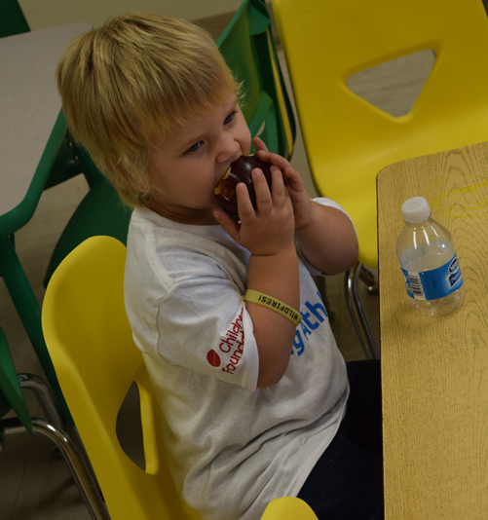
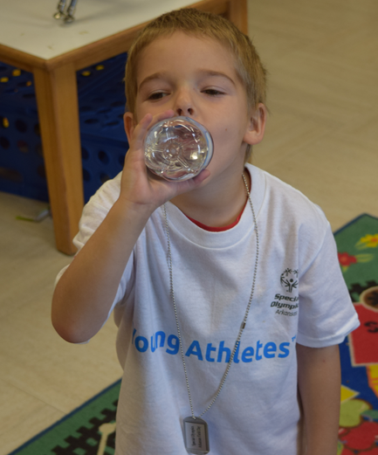
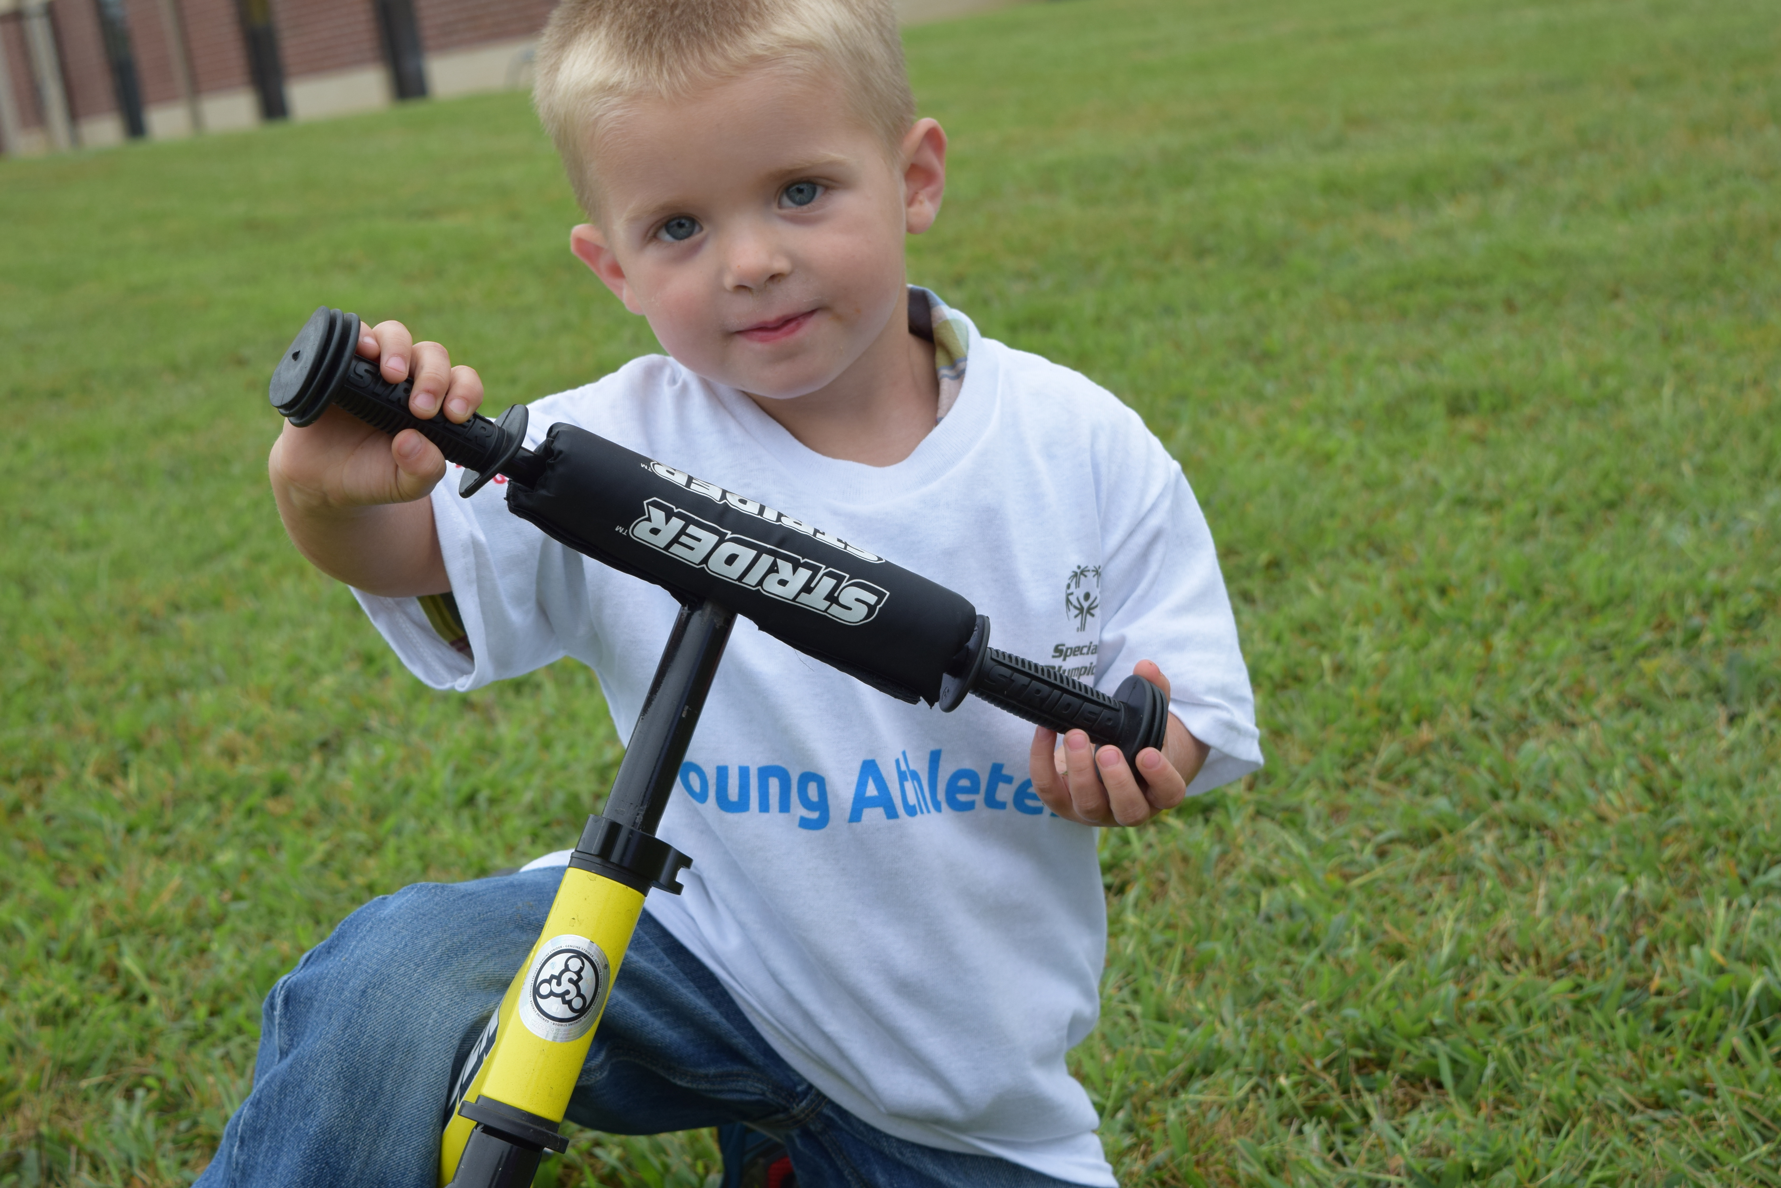
Healthy Young Athletes
Notes:
When Special Olympics Arkansas began this curriculum on 2013 the most frequently asked questions from teachers was “do you have resources for health and wellness as well?” This demand led us to add a Healthy Young Athletes segment. This allows the focus of health and wellness topics in addition to the physical activity curriculum

Slide 28
Health Focus
Nutrition
General
Family Engagement
Hydration
Sun Safety
Hand washing
Oral Health
Strong Bones
Prevention of Smoking
Notes:
Topics that are covered in the Healthy Young Athletes programming are …

Slide 29
Incorporating Health
AETN Healthy Habits for Life Curriculum available http://www.sesamestreet.org/parents/topicsandactivities/toolkits/healthyhabits#
Live Healthy Education Days
Opportunity for Community Engagement
Health Fair layout or class visit layout
Two topics with age appropriate materials and hands on learning
Notes:
The program has partnered with AETN for their Healthy Habits for Life curriculum. This is free to schools/centers and aligns perfectly with the Young Athletes curriculum. Teachers can utilize this curriculum for the two days they are not using YA curriculum or they can run it all five days of the week. It is a flexible and easy to use program.
Special Olympics also encourages episodic events called Live Healthy Education days. These events are executed with a community volunteer or organization that might come in to educate your children on specific health topics. E.g. UA Cooperative extension offices might come out for Hand Washing education, local dentist or dental hygienists might come out for an oral health day.
The Education day is complete when the child receives education training and performs a hands on activity related to the topic

Slide 30
Engaging Families in Health
Fit Families Challenge
Families sign up for 6 week challenge
Teachers can choose to sign up their class
http://www.specialolympicsarkansas.org/fit-families.html
Nutrition Goals
Fitness Goal (4 days a week for 30 minutes)
Unique activation
Incentives/prizes
Notes:
This is an optional program that centers and schools can offer to parents or teachers can sign up their classrooms

Slide 31
Notes:
The following slides are an overview of the Healthy habits for life curriculum. There are section based around nutrition such as a nutrition maze where students are doing more classroom activities like coloring. The other sections are for physical activity designed to educate the students in a fun way encouraging movement.

Slide 32
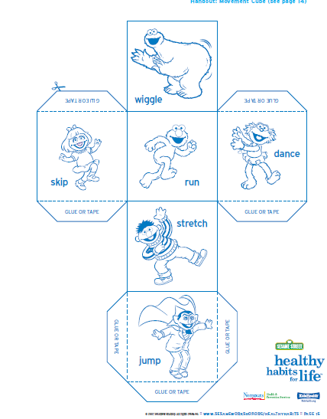

Slide 33
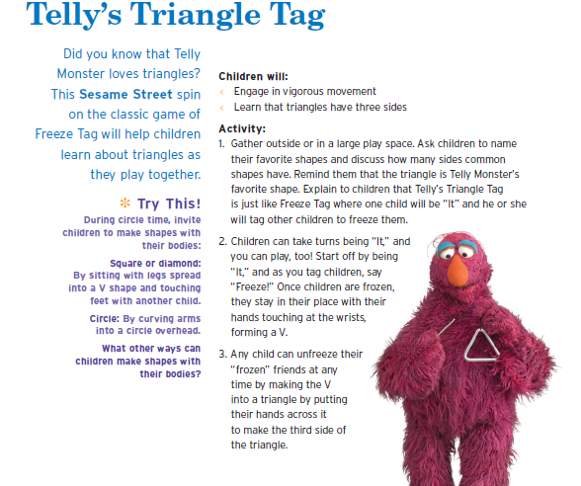

Slide 34
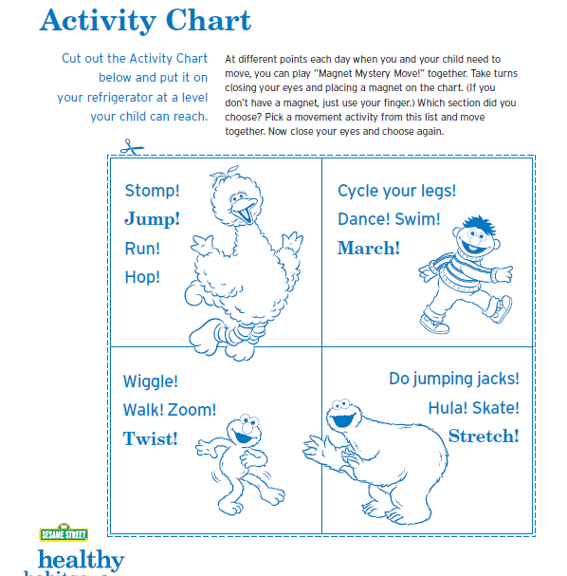

Slide 35
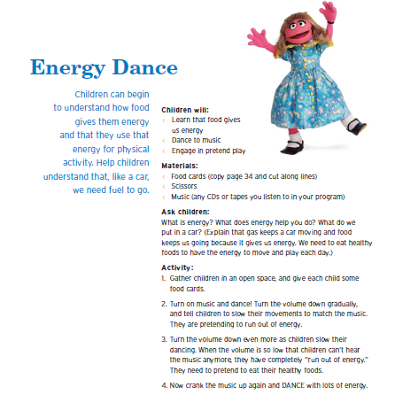

Slide 36
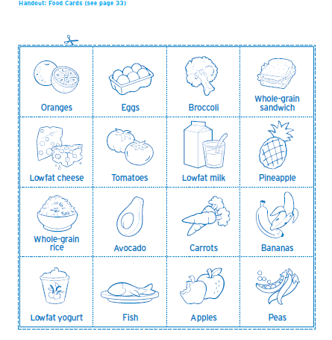

Slide 38
Ideas for after the curriculum
Field Days
Family Event
Community Event
Tied activities to a Health or Safety Fair
Organized Sports
Sport development days
Special Olympics curriculum

Slide 39
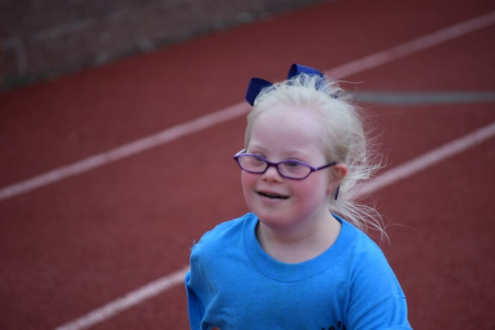
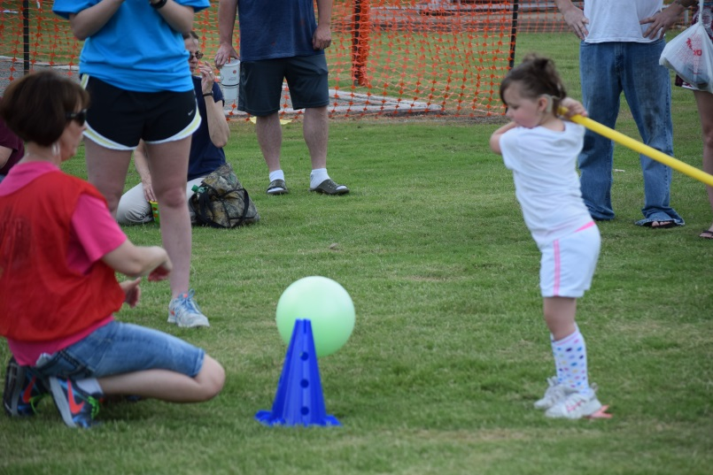
Young Athletes Field Days
Circuit training activities:
14-20 stations(circular design)
opportunity to alternate activities for each field day
Optimal outside set up (unless gymnasium available)
1-2 minutes per station (1-1.5 hours)
Focus skills: Foundational, walking and running, trapping and catching, throwing, striking, kicking, advanced options.
Awards
Each participant awarded participation award
Notes:
Set up a circuit of 14-20 stations. Each student will run each station for 1-2 minutes. Teachers have flexibility to design their own process. The Special Olympics site has recommended activities for Field Days. This is also an opportunity to engage families and community members.

Slide 40
Field Day Pre-planning
Notify Special Olympics Arkansas 60 days prior to desired event date (or as early as you are able)
Jennifer Grantham, Jennifer@specialolympicsarkansas.org 501-771-0222
Any necessary planning meetings will be set up at this time
Volunteers
Depending on your set up and number of children we can determine this exact number during event planning
Rule of thumb 2 per station (Circuit activity and Live Healthy)
Equipment
Young Athlete Activity kit and additional materials needed (awards etc.)
Available Resources

Slide 41
Competition
Area and State level Young Athletes Competitions
Local Area Directors or Field Representatives will have this information
Events: 25m walk, 25m Run, tennis ball throw, individual skills basketball, bowling.
Off-site options for Young Athletes
Competitors can travel as teams or individually with parents
Future On-site options for Young Athletes
Competitions hosted by local Area at your site for our participants
Notes:
Refer parents to the Special Olympics calendar if they have interest in seeking additional opportunities for their athletes

Slide 42
Notes:
This program is a recognized physical activity curriculum for Better Beginnings

Slide 43
To implement this curriculum:
Contact: Jennifer Grantham
Special Olympics Arkansas Director of Field Services Initiatives and Volunteers
Jennifer@specialolympicsarkansas.org or 501-771-0222
Her information is on the inside of your teaser packet as well
Inform her of which training you attended and the presenter
She will have a few questions for you to answer e.g. how many students in your center etc.
You will receive the following at no cost:
one copy of the full curriculum book and activity guide as well as a healthy habits for life curriculum book

Slide 44
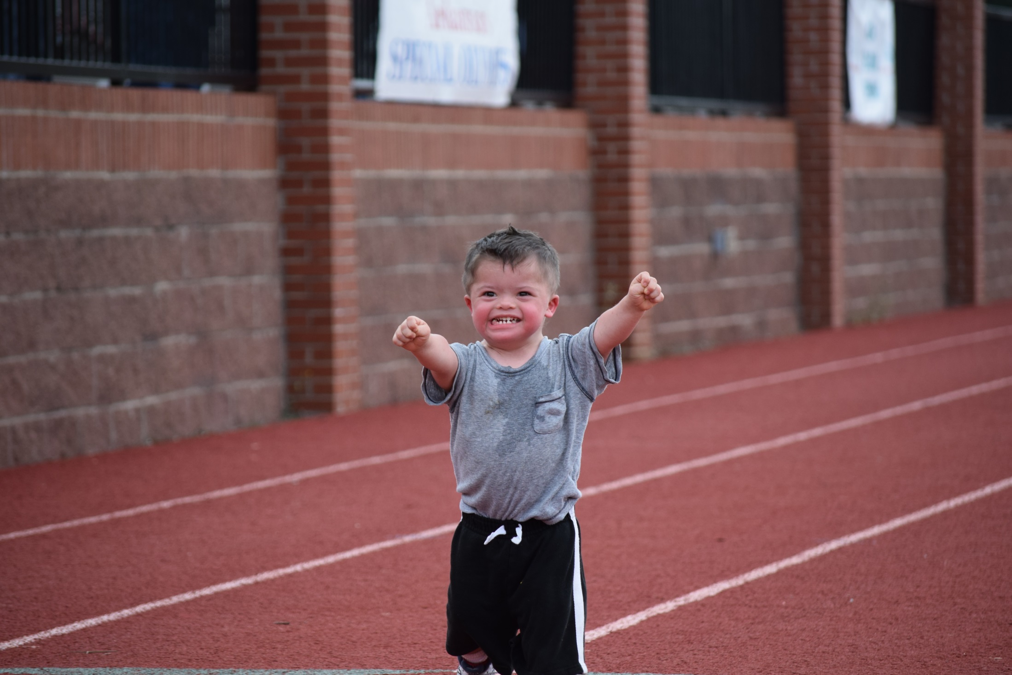
Questions?

